Slide 1
SHIELD Meeting 6/25

Slide 2











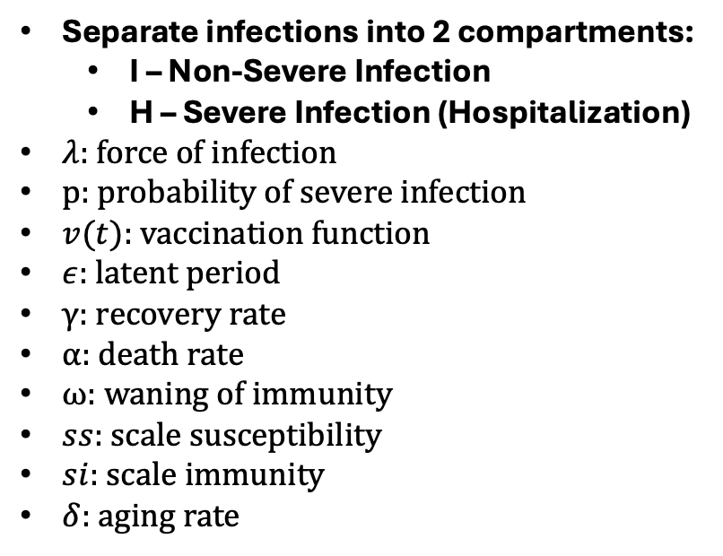



COVID/Flu/RSV SEIR Model
I1
$(1−p_{1})ϵ$
$$γ$$
Separate infections into 2 compartments:
  I – Non-Severe Infection
  H – Severe Infection (Hospitalization)
$λ:$ force of infection
p: probability of severe infection
$v(t)$: vaccination function
$ε$: latent period
$γ$: recovery rate
$α$: death rate
$ω$: waning of immunity
$ss$: scale susceptibility
$si$: scale immunity
$δ$: aging rate
S1
E1
R1
$λ$
$$(1−α_{1})γ$$
H1
$$p_{1}ϵ$$
D1
$$α_{1}$$
$$ω$$
I2
$(1−p_{2})ϵ$
$$γ$$
R2
S2
E2
$ss∗λ$
$$(1−α_{2})γ$$
$$p_{2}ϵ$$
H2
D2
$$α_{2}$$
$$si∙ω$$

Slide 3


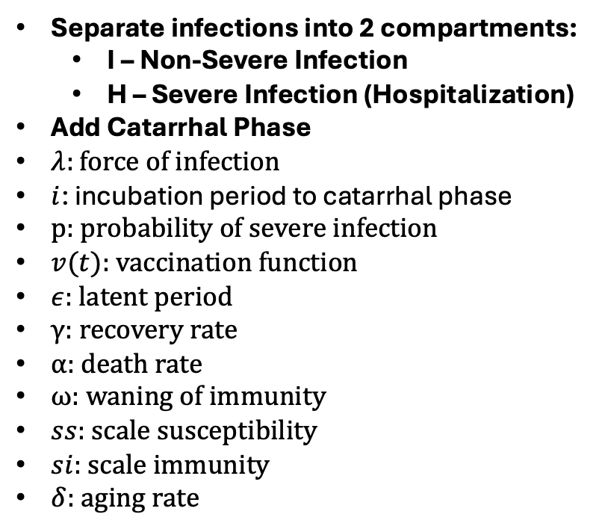












Pertussis SEIR Model
I1
$(1−p_{1})ϵ$
$$γ$$
Separate infections into 2 compartments:
  I – Non-Severe Infection
  H – Severe Infection (Hospitalization)
Add Catarrhal Phase
$λ:$ force of infection
$i$: incubation period to catarrhal phase
p: probability of severe infection
$v(t)$: vaccination function
$ε$: latent period
$γ$: recovery rate
$α$: death rate
$ω$: waning of immunity
$ss$: scale susceptibility
$si$: scale immunity
$δ$: aging rate
S1
E1
C1
R1
$λ$
$$i$$
$$(1−α_{1})γ$$
H1
$$p_{1}ϵ$$
D1
$$α_{1}$$
$$ω$$
I2
$(1−p_{2})ϵ$
$$γ$$
S2
E2
R2
$ss∗λ$
C2
$$i$$
$$(1−α_{2})γ$$
$$p_{2}ϵ$$
H2
D2
$$α_{2}$$
$$si∙ω$$

Slide 4
Current Goals:
Add Seasonality into Model
  Calibrate seasonality on Illinois mortality data
Adapt code to updated SEIR Models

